Slide 1
The Return of Unlexicalized PCFGs

Slide 2
Accurate Unlexicalized Parsing [Klein and Manning 1993]
What do we mean by an “unlexicalized” PCFG?
Grammar rules are not systematically specified down to the level of lexical items
NP-stocks is not allowed
NP^S-CC is fine
Closed vs. open class words
Long tradition in linguistics of using function words as features or markers for selection (VB-have, SBAR-if/whether)
Different to the bilexical idea of semantic heads
Open-class selection is really a proxy for semantics
Thesis
Most of what you need for accurate parsing, and much of what lexicalized PCFGs actually capture isn’t lexical selection between content words but just basic grammatical features, like verb form, finiteness, presence of a verbal auxiliary, etc.

Slide 3
Experimental Approach
Corpus: Penn Treebank, WSJ; iterate on small dev set
Size – number of symbols in grammar.
Passive / complete symbols: NP, NP^S
Active / incomplete symbols: @NP_NP_CC [from binarization]
We state-split as sparingly as possible
Highest accuracy with fewest symbols
Error-driven, manual hill-climb, one annotation at a time
Training: | sections | 02-21
Development: | section | 22 (first 20 files) ⬅
Test: | section | 23

Slide 4
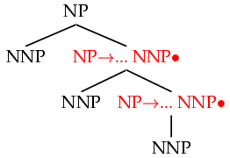
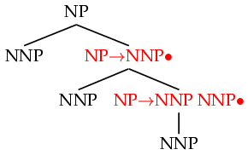

Horizontal Markovization
Horizontal Markovization: Merges States
Merged
Notes:
Say that a lot of what the lexicalized parsers were doing was other stuff that was nothing to do with lexicalization.
Collins (1997) did this.

Slide 5
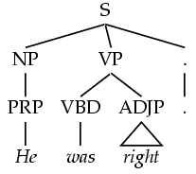
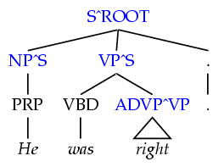
Vertical Markovization
Vertical Markov order: rewrites depend on past k ancestor nodes.
(i.e., parent annotation)
Order 1
Order 2
Model | F1 | Size
v=h=2v | 77.8 | 7.5K
Notes:
We saw that Charniak (1997) did this.

Slide 6
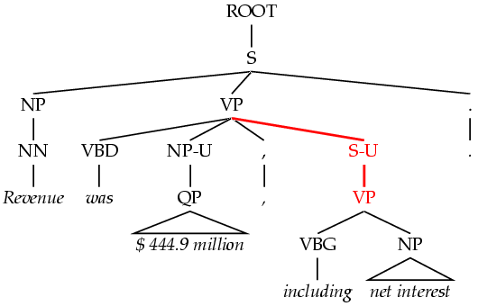

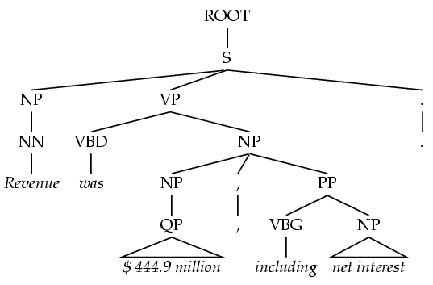
Unary Splits
Problem: unary rewrites are used to transmute categories so a high-probability rule can be used.
Solution: Mark unary rewrite sites with -U
Annotation | F1 | Size
Base | 77.8 | 7.5K
UNARY | 78.3 | 8.0K

Slide 7
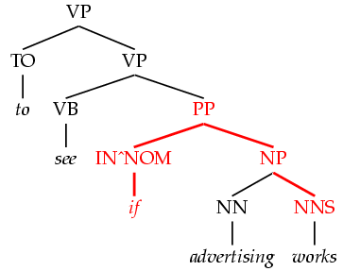
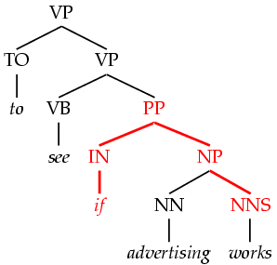
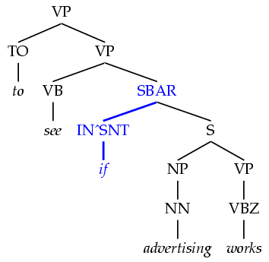
Tag Splits
Problem: Treebank tags are too coarse.
Example: SBAR sentential complementizers (that, whether, if), subordinating conjunctions (while, after), and true prepositions (in, of, to) are all tagged IN.
Partial Solution:
Subdivide the IN tag.
Annotation | F1 | Size
Previous | 78.3 | 8.0K
SPLIT-IN | 80.3 | 8.1K

Slide 8
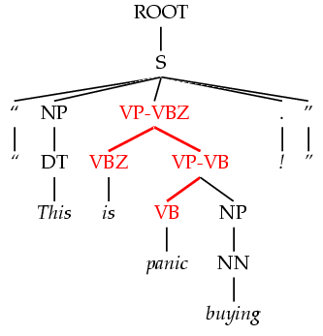
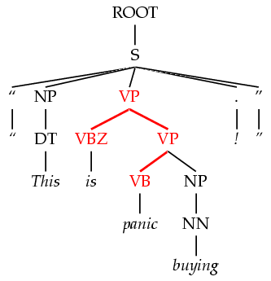
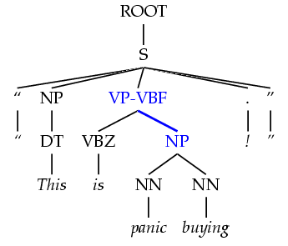
Yield Splits
Problem: sometimes the behavior of a category depends on something inside its future yield.
Examples:
Possessive NPs
Finite vs. infinite VPs
Lexical heads!
Solution: annotate future elements into nodes.
Annotation | F1 | Size
tag splits | 82.3 | 9.7K
POSS-NP | 83.1 | 9.8K
SPLIT-VP | 85.7 | 10.5K

Slide 9
Distance / Recursion Splits
Problem: vanilla PCFGs cannot distinguish attachment heights.
Solution: mark a property of higher or lower sites:
Contains a verb.
Is (non)-recursive.
Base NPs [cf. Collins 99]
Right-recursive NPs
NP
-v
VP
NP
PP
v
Annotation | F1 | Size
Previous | 85.7 | 10.5K
BASE-NP | 86.0 | 11.7K
DOMINATES-V | 86.9 | 14.1K
RIGHT-REC-NP | 87.0 | 15.2K

Slide 10
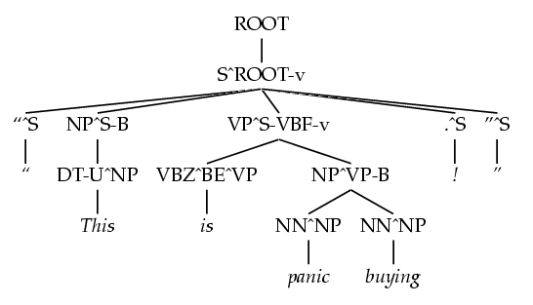
A Fully Annotated Tree

Slide 11
Final Test Set Results
Parser | LP | LR | F1
Magerman 95 | 84.9 | 84.6 | 84.7
Collins 96 | 86.3 | 85.8 | 86.0
Klein & Manning 03 | 86.9 | 85.7 | 86.3
Charniak 97 | 87.4 | 87.5 | 87.4
Collins 99 | 88.7 | 88.6 | 88.6
Beats “first generation” lexicalized parsers

Slide 12
The Return of Unlexicalized PCFGs

